Slide 1

Git
version control
Mattia Mencagli
m.mencagli@cineca.it
22/04/2024

Slide 2


git
Distributed version control system created by Linus Torvalds.

Slide 3


git
Version control vs. GitHub or GitLab
Version control is a system that records changes to a file or set of files over time so that you can recall specific versions later.
GitHub or GitLab are developer C that allows developers to create, store, manage and share their code through git software.
/

Slide 4
git
git clone
You want to get a copy of an existing git repository?
> git clone <remote_url> <local_dir>
That creates a directory named <local_dir>,
initializes a .git/ directory inside it (that is your local repository),
And pulls down all the data for that repository.
The actual url: https://github.com/mattiamencagli/repository.git
<remote_url>:
The SSH supported url: git@github.com:mattiamencagli/repository.git

Slide 5
git
git config
Configure most used your account to use your git repositories with SSH-key protocol:
> git config --global user.email youremail@domain.com
> git config --global user.name "yourname"
Configure a local account for a specific repository:
> git config --local user.email youremail@domain.com
> git config --local user.name "yourname"
Check your configuration:
> git config --list
git config will give different informations in different repositories!

Slide 6
git
git states
Modified means that you have changed the file but have not committed yet it to your database yet.
Staged means that you have marked a modified file in its current version to go into your next commit snapshot.
Committed means that the data is safely stored in your local database.
Working directory
Staging Area
.git directory (local repository)
Checkout the project
Stage fixes
Commit
git thinks about its data like a stream of snapshots, each commit is a snapshot.

Slide 7
git
Files life-cycle
Untracked
Unmodified
Modified
staged
1. Add the file to the repository
Edit the file
3. Move the file
2. Remove the file
4. Commit
1.
2.
> git add <files>
> git add -A
> git rm <files>
3.
4.
> git mv <old_f> <new_f>
> git commit -m “your commit text”

Slide 8
git
file status & ignored files
Viewing your staged and unstaged changes:
> git status
.gitignore example:
To see what you’ve changed but not yet staged:
*.o
*.x
*.dat
!*ini.dat
build*/
.vscode/
> git diff <file>
A file listing patterns to match the names of files that will be ignored by git actions.
> vim .gitignore

Slide 9
git
Undoing thing
Improve the previous commit:
> git commit --amend
> git checkout --staged <file>
> git reset HEAD <file>
Unstage a staged file:
> git restore <file>
> git checkout <file>
Unmodify a modified file:
> git log
> git log --all --oneline --decorate --graph
Check the history of your commits:

Slide 10
git
Branches
A branch in git is a movable pointer to one of the commits.
Branch_2
Create a new branch:
master (main)
> git branch <branch_name>
Switch to an existing branch:
Branch_1
Branch_1.2
> git checkout <branch_name>
HEAD
HEAD is a particular pointer. It always point to the local branch you’re currently on.

Slide 11

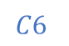
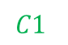
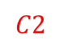

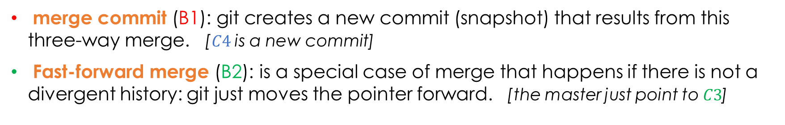
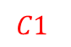

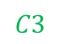

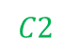
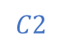
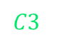
git
Merge branches
master (main)
Merge two branches:
$$C1$$
$$C2$$
$$C3$$
$$C4$$
$$C5$$
$$C3$$
$$C6$$
> git merge <branch>
$$C1$$
$$C2$$
$$C1$$
$$C2$$
$$C3$$
B1
B2
merge commit (B1): git creates a new commit (snapshot) that results from this three-way merge. [$C4$ is a new commit]
Fast-forward merge (B2): is a special case of merge that happens if there is not a divergent history: git just moves the pointer forward. [the master just point to $C3$]

Slide 12
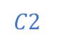
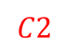

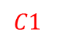

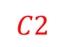

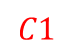


git
Rebase branches
Take all the changes committed in the current branch and reapply them on top of <branch>:
> git rebase <branch>
Before rebase:
After rebase:
$$C1$$
$$C2$$
$$C3$$
$$C1$$
$$C2$$
$$C3$$
master (main)
master (main)
$$C1$$
$$C2$$
$$C1$$
$$C2$$
B1
B1

Slide 13
git
Remote repository
Remote repositories are versions of your project that are hosted on the Internet or network (e.g., GitHub or GitLab). Very useful to collaborate with others or share your work.
If you have cloned the remote repository, you can check it:
> git remote -v
Otherwise, you can initialize your new local repository, and then add a remote one:
> git init
> git remote add <repo_name> <repo_url>
origin

Slide 14
git
git pull
> git fetch <remote>
Pulls down all the data from the remote project. You will have references to all the remote branches, which you can merge with your local branch in or inspect at any time.
> git merge <branch>
Automatically fetch and then merge the remote branch into your current local branch.
> git pull <remote> <branch>

Slide 15


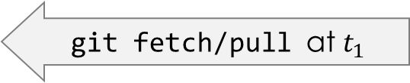

git
git push
> git push <remote> <branch>
This command works only if you clone from a server to which you have write access and if nobody has pushed in the meantime. If you push after a collaborator push, your push will rightly be rejected. You must fetch their work first and incorporate it into yours before you’ll be allowed to push.
git push at $t_{0}$
Common remote repository
collaborator
Wrong!
you
git push at $t_{1}$
you
git fetch/pull at $t_{1}$
Correct!
git push at $t_{2}$

Slide 16

git
References
Book: https://git-scm.com/book/en/v2
GitHub documentation: https://docs.github.com/
GitLab documentation: https://docs.gitlab.com/

Slide 17
End
Mattia Mencagli
m.mencagli@cineca.it

Slide 18
git live session
start
If you don’t have one, create a ssh key:
> ssh-keygen

Slide 19
EXTRA: git
SSH key
If you don’t have one, create a ssh key:
> ssh-keygen
If you don’t choose a custom name, directory or password, your private and public keys will be in the directory ${HOME}/.ssh/ as: id_rsa and id_rsa.pub
Add the content of your PUBLIC key in GitHub (https://github.com/settings/keys) or GitLab (https://gitlab.com/-/profile/keys), or your favorite platform.
Remember: NEVER share your PRIVATE key outside of your local machine.

Slide 20
EXTRA: git
Custom line prompt
Inside .bashrc, following the example below, export the git variables and add in the PS1 variable a string as “git_string”:
export GIT_PS1_SHOWCOLORHINTS=1 export GIT_PS1_SHOWDIRTYSTATE=1 export GIT_PS1_SHOWUNTRACKEDFILES=1 export GIT_PS1_SHOWUPSTREAM=1
user='\[\e[1;31m\]\u’ host=‘\[\e[0;35m\]@\h’ work_dir='\[\e[1;36m\]\w’ dollar='\[\e[1;32m\]\$’ input='\[\e[0;37m\] ‘
git_string=‘\[\e[1;93m\]$(__git_ps1 "(%s)")’
PS1=${user}${host}${work_dir}${git_string}${dollar}${input}
You can choose different colors changing the piece of string in the front: “\[\e[1;93m\]”. More informations about PS1 and its colors here: link1, link2.
currentbranch
modified files
untracked files
upstream state

